Slide 1

Gfdnavi: A tool to archive, share, distribute, analyze, and visualize geophysical fluid data and knowledge
Seiya Nishizawa, Takeshi Horinouchi,
Chiemi Watanabe,
T. Koshiro, A. Tomobayashi, S. Otsuka,
Y. Morikawa, Y.-Y. Hayashi, M. Shiotani, and
GFD Dennou Davis project

Slide 2
What is Gfdnavi
= Geophysical fluid data navigator
A suite of software to construct Web-based database of geophysical fluid data
基本機能:
  検索
  データ解析・可視化
  解析結果(知見)の文書化

Slide 3
Background

Slide 4
Web-based database and analysis tools の問題点
Limited analysis capability
→ You often end up with downloading data
Not very suitable to desktop use
→ Service are not available to local data
We would rather like to extend desktop tools (such as IDV) to cover persistent data services

Slide 5
More on the analysis capability
Impossible to predefine sufficient functionality (since we are scientists)
→ Programmability is the key
Programmability in two ways:
  Programmable on web-browser
  Web-service API (program locally)
→ Both are desirable

Slide 6
Visualization is not the goal
To others (scientists / society): reports
While working: memos / internal documents
To collaborators: reports / know-how / discussion
Outputs are documents
(not just pieces of images)

Slide 7
Foundation of Gfdnavi

Slide 8
Two fundamental libraries used to build Gfdnavi (open-source)
GPhys – a Ruby library to analyze and visualize geophysical fluid data (by Horinouchi etc since 2003)
  For consolidated access to data in files (NetCDF, GRIB, GrADS, NuSDAS, HDF5-EOS) or on runtime memory – A community infrastructure for data analysis (We use Ruby daily!) [http://ruby.gfd-dennou.org/] (since 1999)
Ruby on Rails – Development framework for Web application with RDB (since 2005)
  Made it drastically easy to develop RDB-backed Web applications
  Written in/for Ruby → We can use GPhys directly

Slide 9
GPhys (Gridded Physical quantity)
has 1
a GPhys
array data (VArray)
has 1
grid (Grid)
has rank
axis(Axis)
has 1
coord.var.(VArray)1D
has 0..
others (VArray)1D
has 0..
AssocCoords (GPhys) Multi-D
(new)
VArray (Virtual Array) – Abstracts Data Storage
(Can be in file(s) or multi-D Array on memory; can also
be a subset or aggregation of (an)other VArray(s))

Slide 10
Introducing Gfdnavi
Since 2006
Early History (Aug 2006):
Rough design by Horinouchi etc (at a meeting of the GFD-Dennou davis project)
First implementation by Nishizawa – In two weeks (since then he is the most contributing to its development)

Slide 11
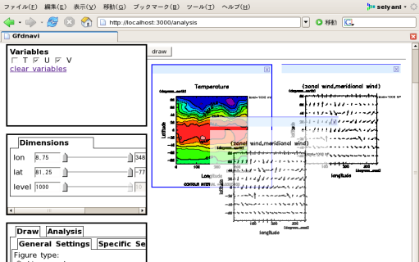
Overview
RDB (metadata etc)
Local file system
(or opendap dir)
meta data scan
sync with DB
O/R mapping
Gfdnavi
MVC
core
Web
server
(webrick/
Apache)
access numerical
data
Web service
Browser Access
User

Slide 12
Metadata DB
used for search
name-value attributes
geospatial- and time-coordinate information
owner, groups and access mode
link among data
time-stamp, size, etc

Slide 13
1. Name-Value attributes
attributes in data file (self-describing files)
  unified access to attributes in differently formatted files with GPhys
attributes in text file
  YAML format
  any name-value attributes
gphys_nc = GPhys::IO.open(“fname.nc”,”T”) # NetCDF
gphys_nc.att_names #=> [“long_name”, …]
gphys_nc.get_att(“standard_name”) #=> “air_temperature”
gphys_grib = GPhys::IO.open(“fname.grib”, “TMP”) # GRIB
gphys_grib .att_names #=> [“long_name”, …]
gphys_grib.get_att(“standard_name”) #=> ”air_temperatrue”
description: NCEP/NCAR reanalysis
gfdnavi:
owner: user1
other_mode: 0
rgroups:
- groupA
- groupB

Slide 14
YAML
a human-readable data serialization format
  easier to read/write than XML
Array (list)
---
- 0
- 1
- 2
Hash (associative array)
---
key1: value0
key0: value1
puts “Array (list)”
ary = [0,1,2]
puts ary.to_yaml
puts “\nHash (associative array)”
hash = {“key0”=>”value0”, ”key1”=>”value1”}
puts hash.to_yaml
Back

Slide 15
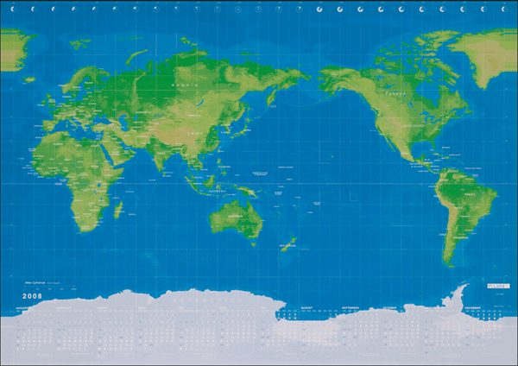
2. Geospatial- and time-coordinate information
  spatial region
    rectangle in longitude-latitude section
  temporal region
    start time and end time
global, regional, or point
swath

Slide 16
3. Owner, Groups, and Access mode
  permission system like i-node
    readable and writable for groups and others
  Multiple groups are allowed.
4. Link among data
  e.g. This data was calculated from these variables

Slide 17
Directory tree structure
nodes in the tree structure
  node types: directories, variables, images, knowledges, etc
Each node can have some metadata.
  inherited to children nodes
variables
data files
local or opendap directories
groups
attributes
description = “……..”
param1 = value1
param2 = [value21,value22]
attributes
description = “……..”
owner = userA
groups = [groupA,groupB]
virtual aggregated files
image files

Slide 18


What is Ruby on Rails http://www.rubyonrails.org/
Web development framework in Ruby
With RDBMS (Mysql, Postgres, SQL Server, SQLite etc)
Strong prototyping (e.g. Model-View-Controller (MVC) architecture)
Has a private web server (Webrick); also runs on Apache, lighttpd etc
  → One can personally run a web server anywhere with arbitrary port

Slide 19
Convention over Configuration (CoC)
Don't repeat yourself (DRY)
swift development
  ActiveRecord
  helper methods (HTML, JavaScript, ajax)
  Ruby-embedded html (eRuby)
Notes:
philosophy

Slide 20
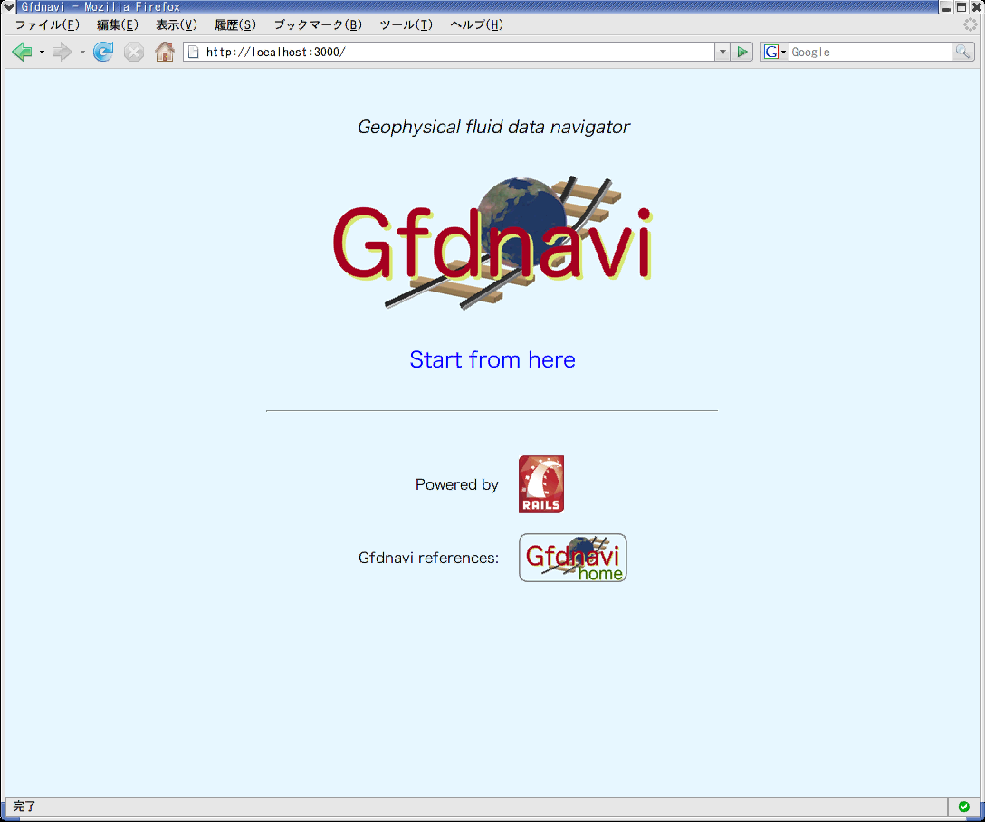
User Interface
Home : Independent simple html → replaceable

Slide 21
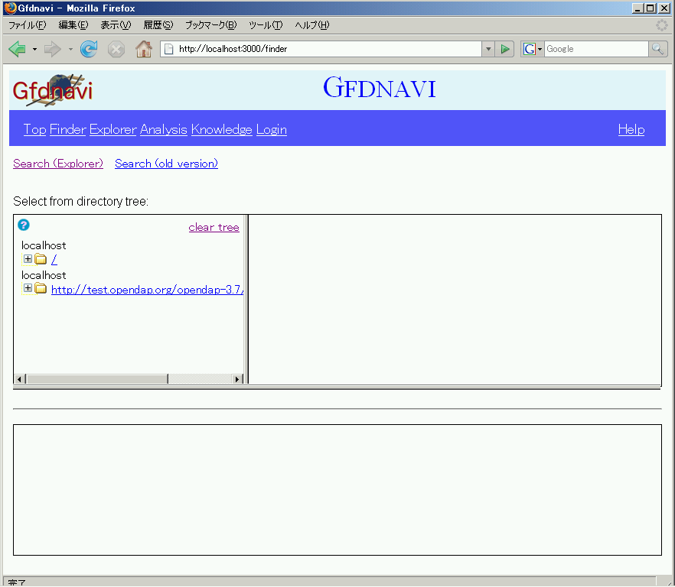

Slide 22

Functionality
Browse directory
tree (Finder)
Search
(Explorer)
Browser UI Header
Select numerical data
Select
Typical work flow to use Gfdnavi’s browser UI
Visualize / analyze
(Analysis)
View docs
(Knowledge)
repeat
Write knowledge
document

Slide 23
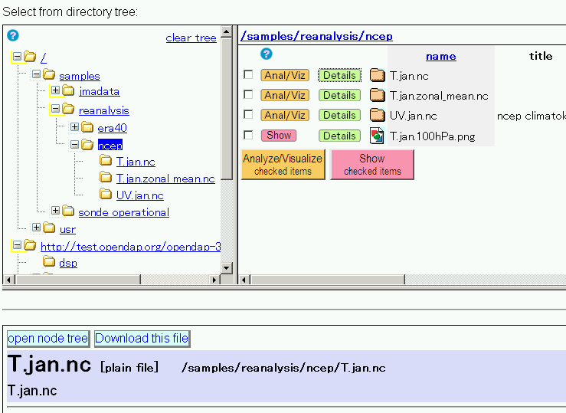
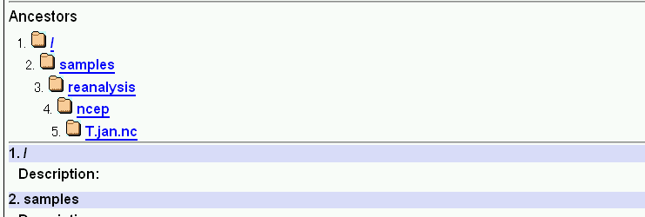
Functionality
Select variables in
this file to analyze /
visualize
MS Explorer-like
tree
Browse directory
tree (Finder)
Search
(Explorer)
Directory
contents
Further details
(metadata)
Select numerical data
Select
Visualize / analyze
(Analysis)
View docs
(Knowledge)
repeat
Write knowledge
document

Slide 24
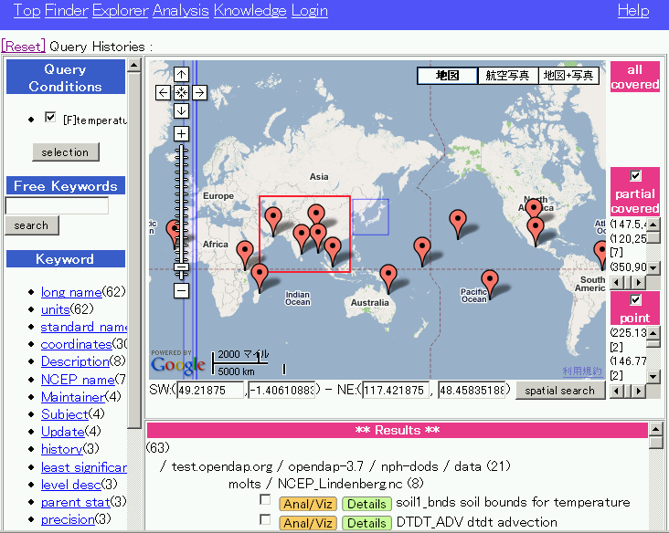
Functionality
Browse directory
tree (Finder)
Search
(Explorer)
Select numerical data
Free text
Select
Visualize / analyze
(Analysis)
View docs
(Knowledge)
Attributes
Search with Google Maps
repeat
Select a variable to analyze / visualize
Write knowledge
document
Results

Slide 25
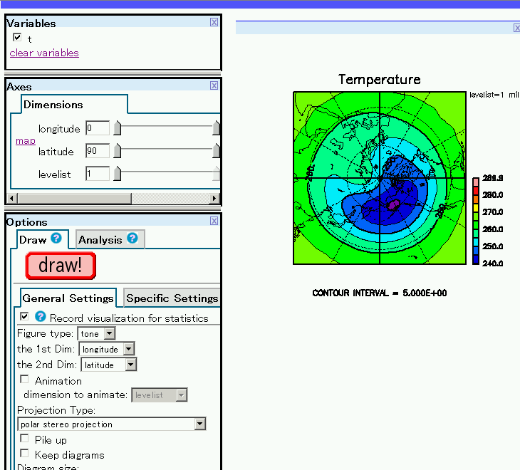
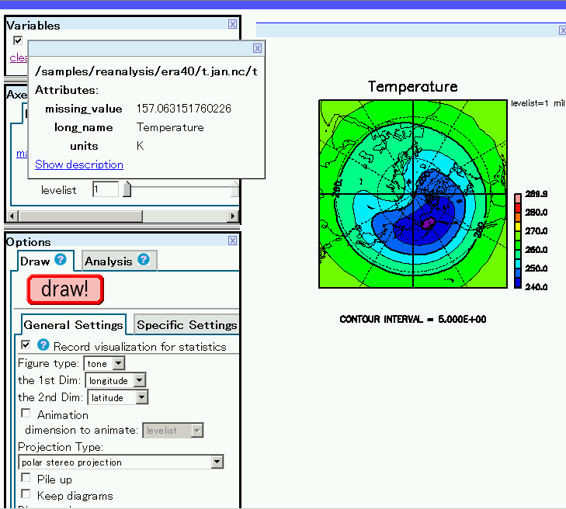

Functionality
Browse directory
tree (Finder)
Search
(Explorer)
Select numerical data
Select
Visualize / analyze
(Analysis)
View docs
(Knowledge)
Ruby Script & Minimum Subset Data
Save in the DB (login needed)
repeat
Draw method: You can supply your own
Get the URL to redraw the img
Write knowledge
document
Animation

Slide 26
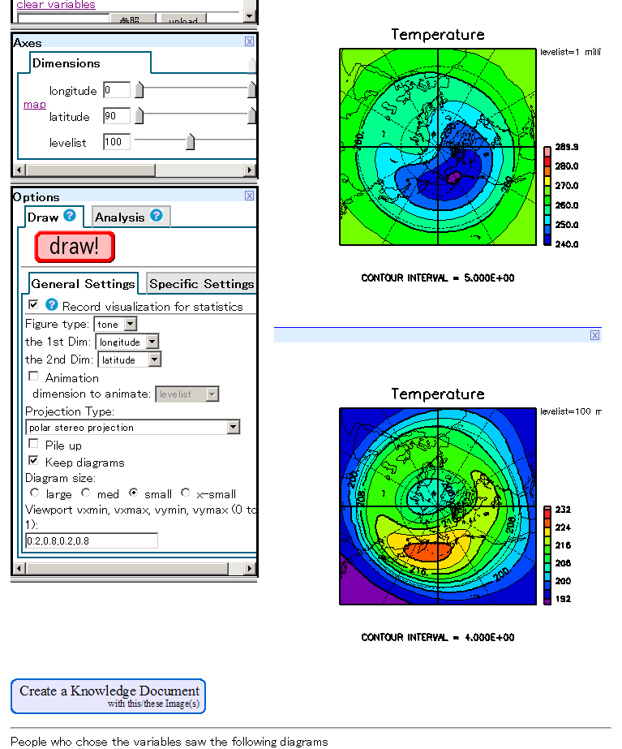
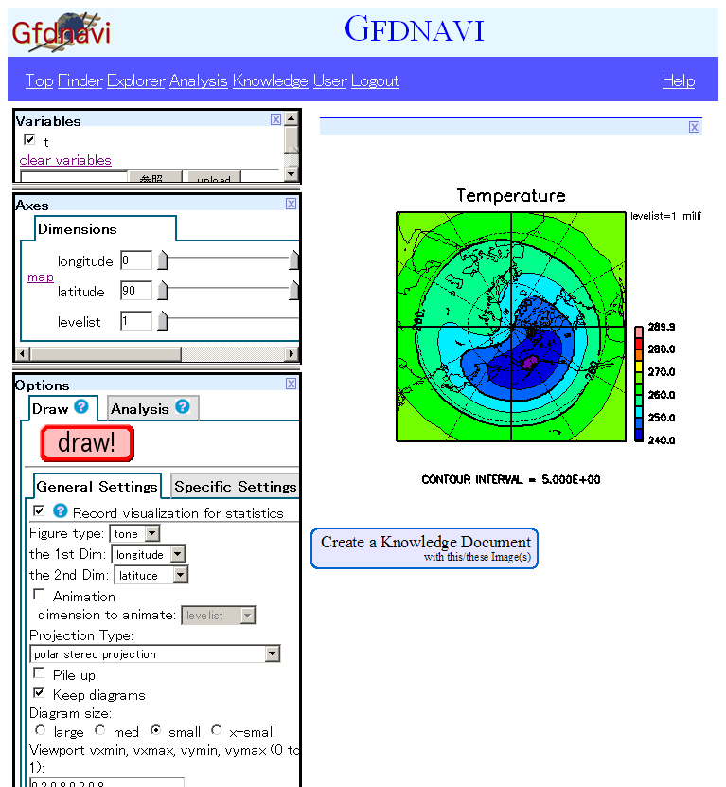
Functionality
Browse directory
tree (Finder)
Search
(Explorer)
Select numerical data
Select
Visualize / analyze
(Analysis)
View docs
(Knowledge)
repeat
Write knowledge
document

Slide 27
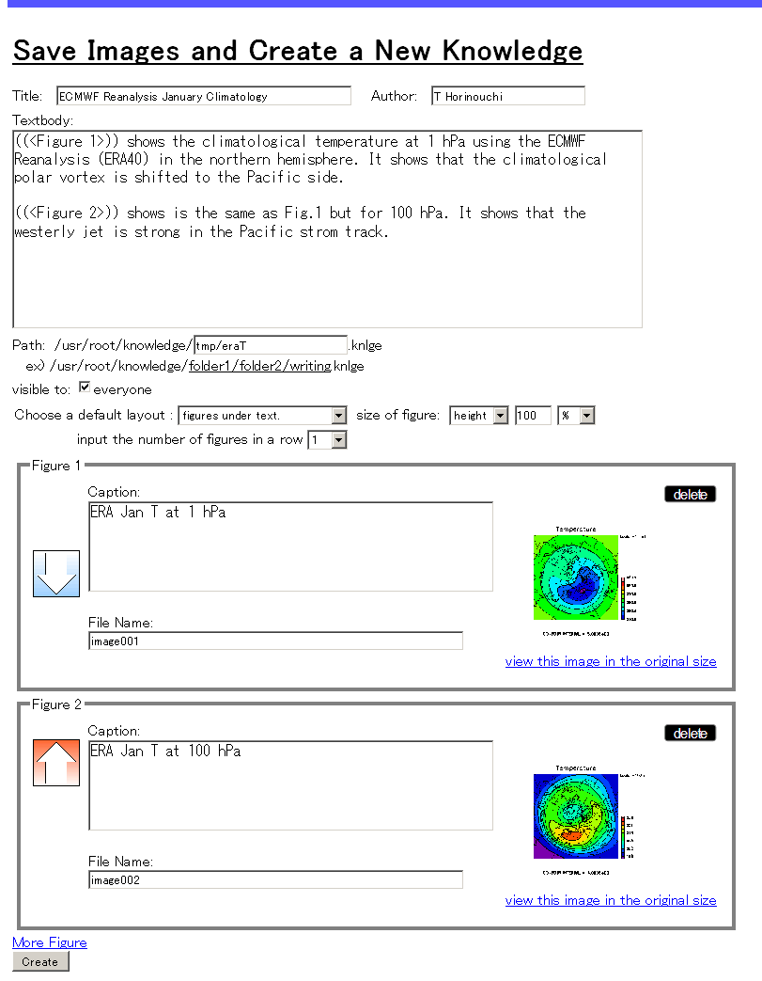
Functionality
Browse directory
tree (Finder)
Search
(Explorer)
Select numerical data
Select
Visualize / analyze
(Analysis)
View docs
(Knowledge)
repeat
Write knowledge
document

Slide 28
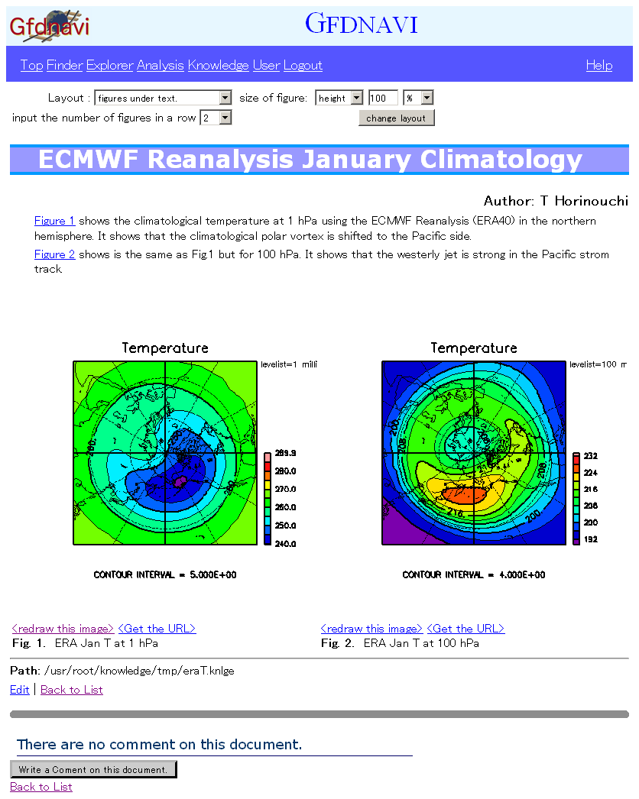
Functionality
Browse directory
tree (Finder)
Search
(Explorer)
Select numerical data
Select
Visualize / analyze
(Analysis)
View docs
(Knowledge)
View docs
(Knowledge)
repeat
Write knowledge
document

Slide 29
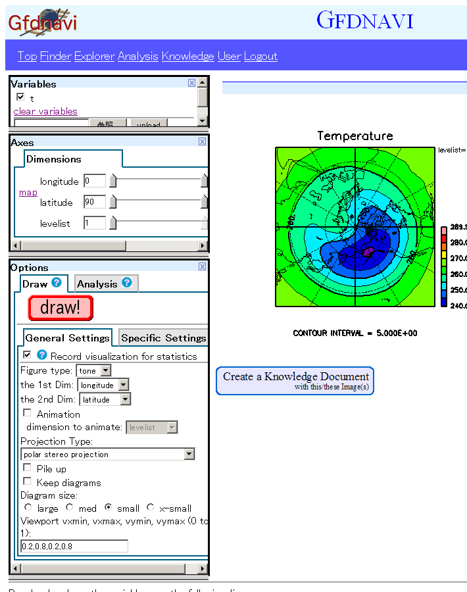
Functionality
Browse directory
tree (Finder)
Search
(Explorer)
Select numerical data
Select
Visualize / analyze
(Analysis)
View docs
(Knowledge)
repeat
Write knowledge
document

Slide 30
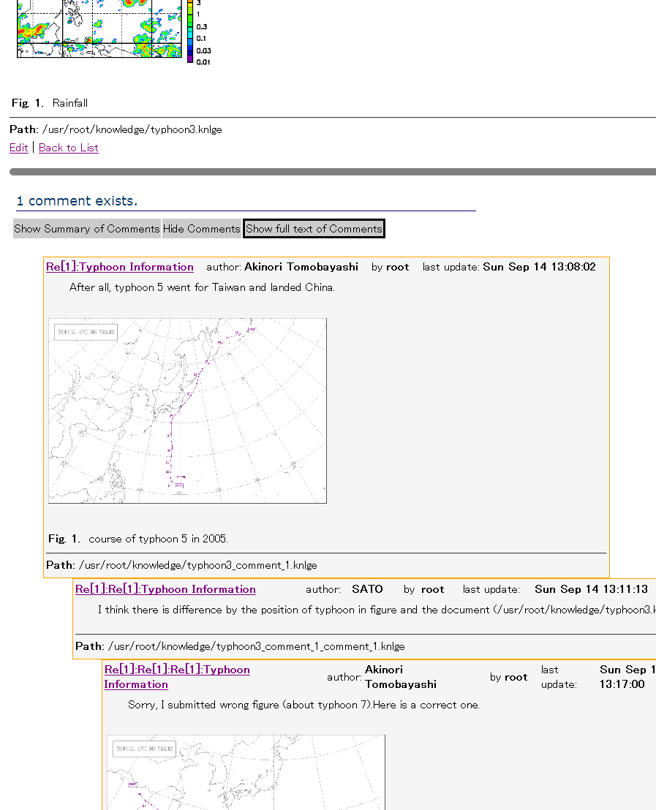
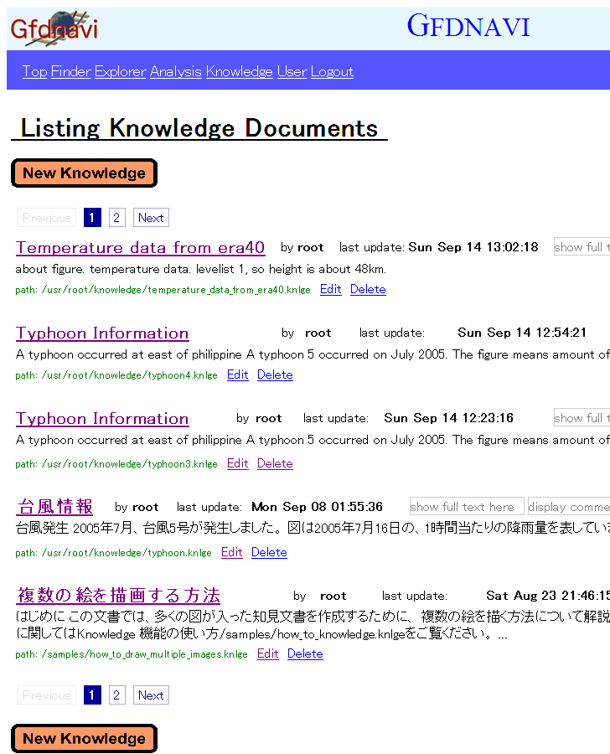
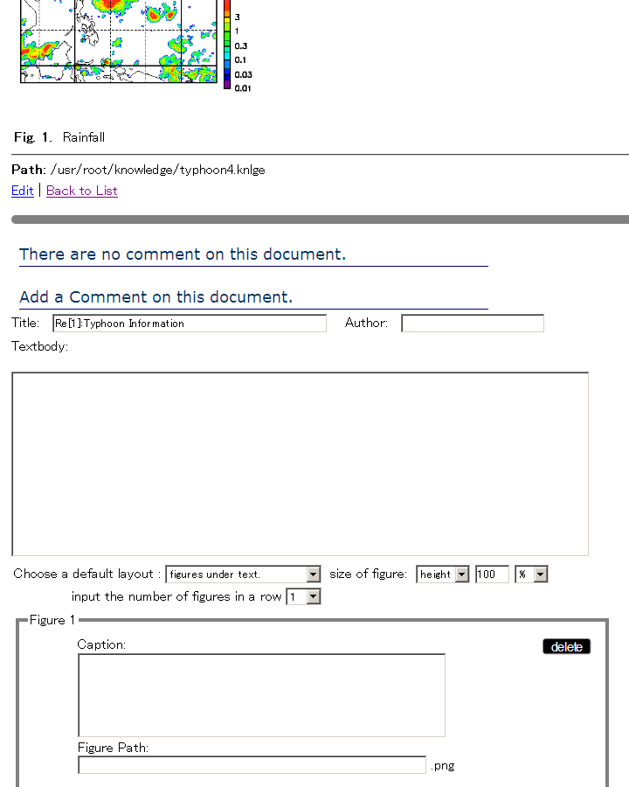
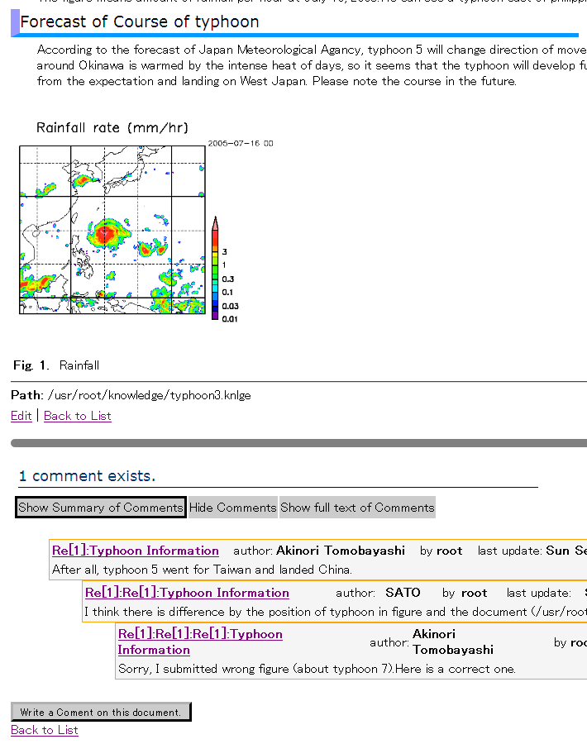
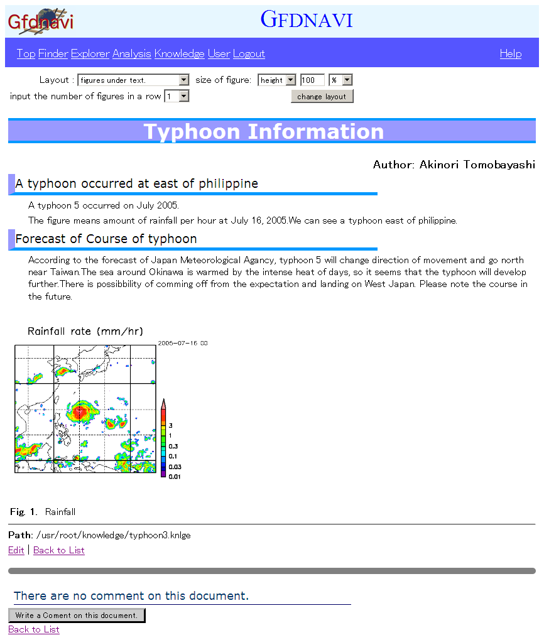
Functionality
Browse directory
tree (Finder)
Search
(Explorer)
Select numerical data
Select
Visualize / analyze
(Analysis)
View docs
(Knowledge)
repeat
Write knowledge
document

Slide 31
Animation
  the 1st loop
    ajax requests (one request for one image)
    may take a little long time
  the later loops
    cached image (cached as JavaScript object)

Slide 32
Animation

Slide 33
Programable
解析メソッドおよび描画メソッドはユーザーが独自のメソッドを追加することができる

Slide 34
Analysis and Visualization
Analysis model
draw
cached
yes
get cache
analysis
no
fork a child process
DB
GPhys
storage
open data file(s)
cache
output
calculate
draw
output
NetCDF
programmable
PNG

Slide 35
Analysis model (Analysis class)
  all the parameters for analysis or visualization
    the form in the analysis page
    instance variables of the Analysis object
  It is able to construct one from the other
    enable to reconstruct the analysis page from
      drawn image
      history list

Slide 36
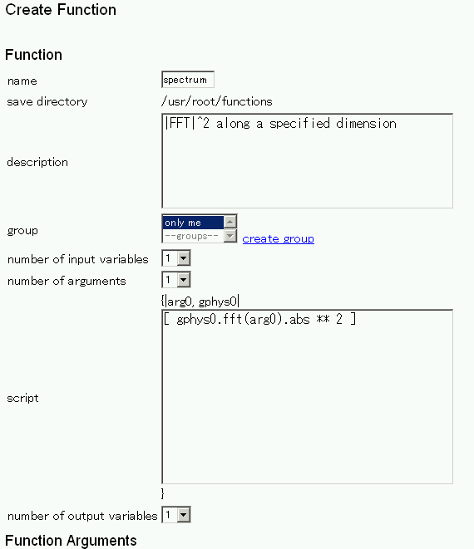
Draw method and analysis function are not hard-coded.
  Their definitions are in YAML files (editable)
    one method in one file
can create and modify
via web-browser
spectrum.yml
:name: spectrum
:description: |FFT|^2 along a specific dimension
:nvars: 1
:script: |
[gphys0.fft(*arg0).abs ** 2]
:arguments:
- :description: the dimensions for spectrum
:value_type: array_string
:default: []
simple coding due to GPhys

Slide 37
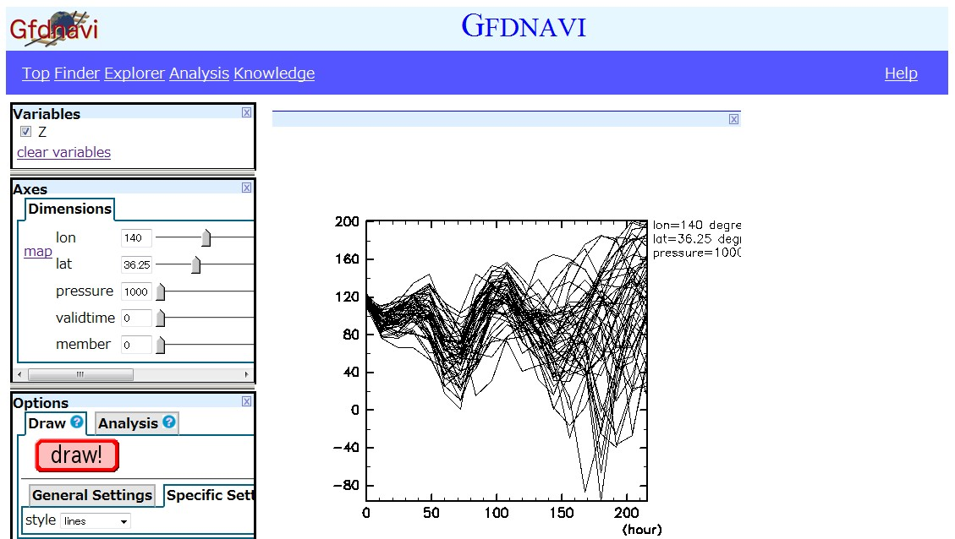
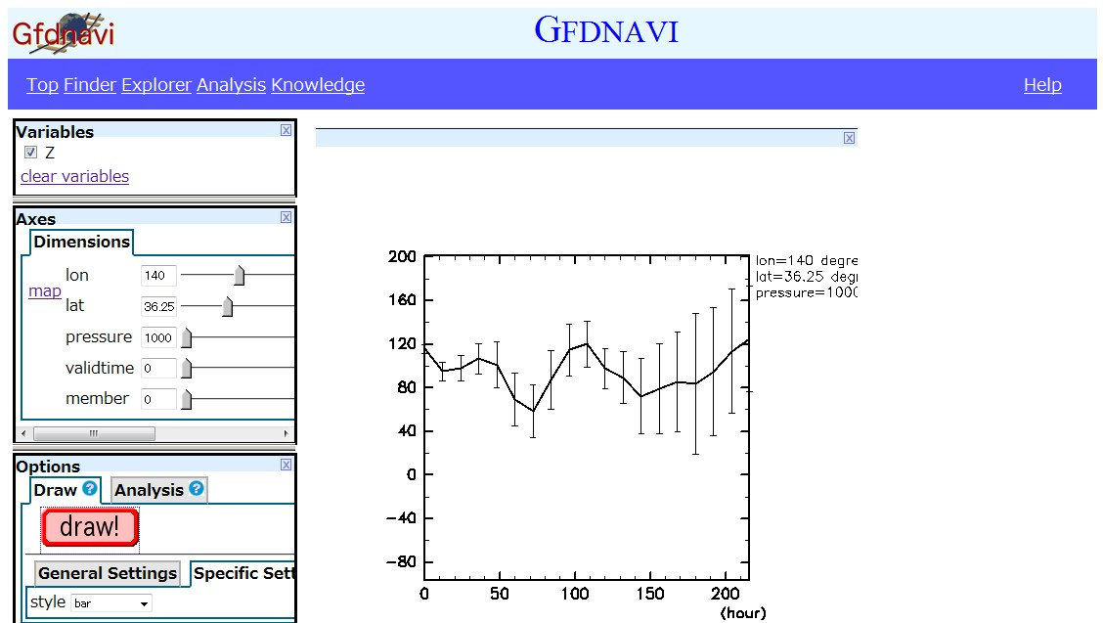
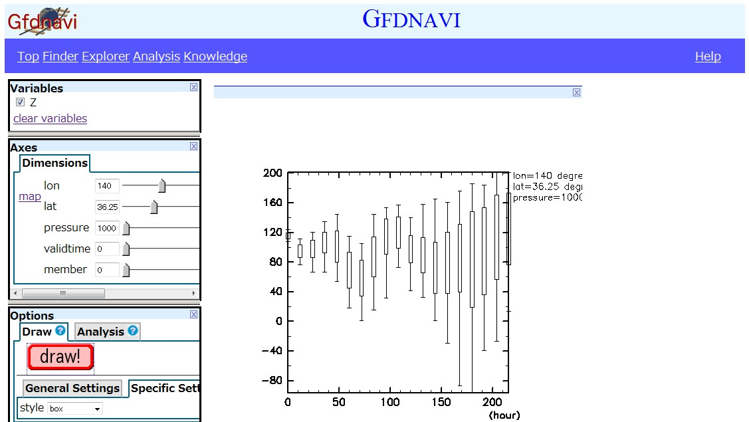
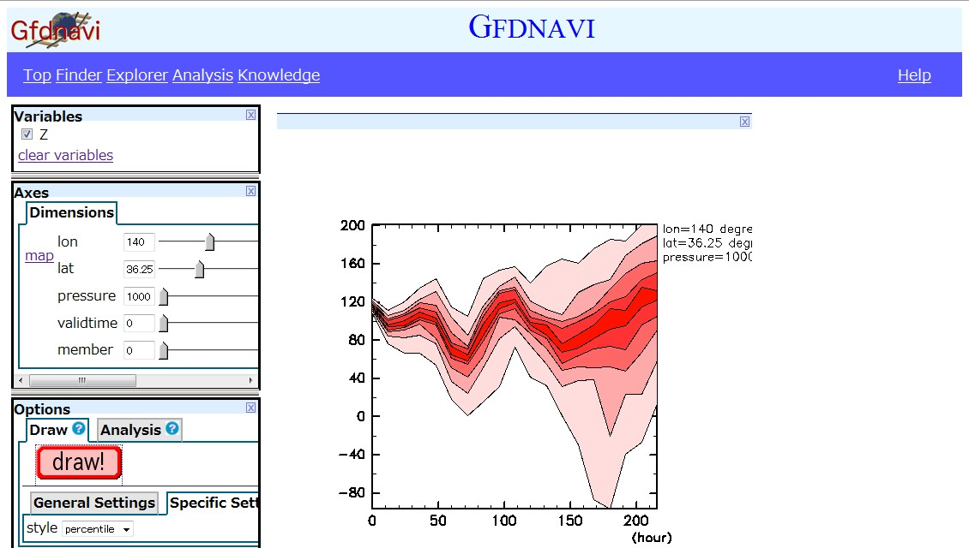
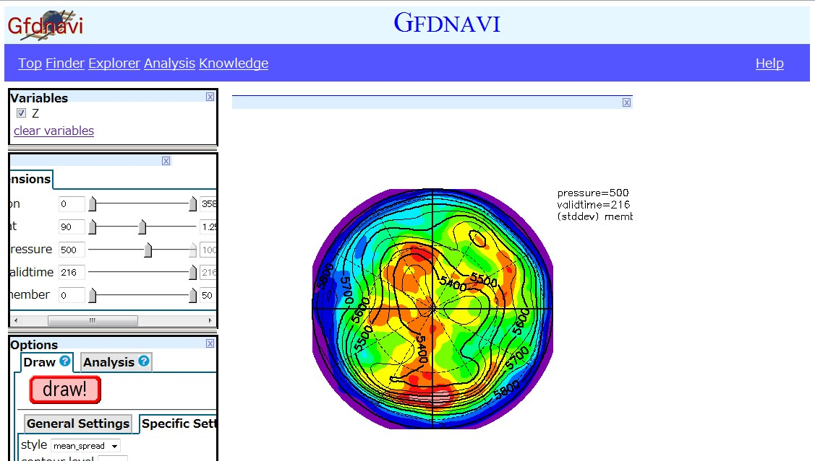
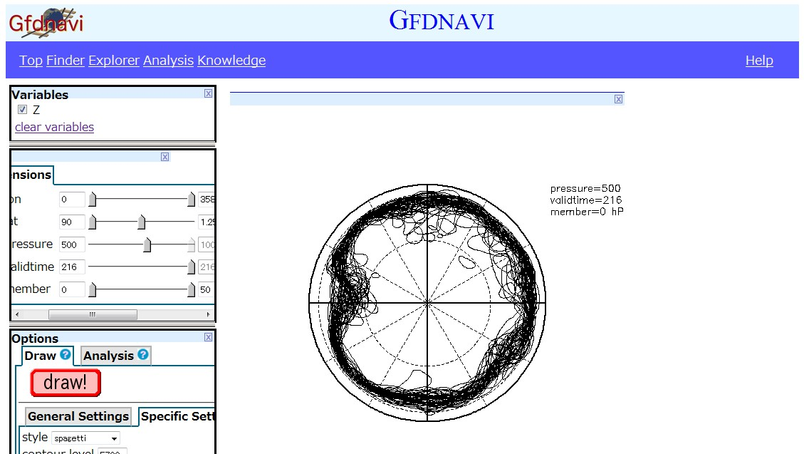
examples of original draw methods in a Gfdnavi server providing an ensemble forecast data

Slide 38
Web service
local programming
cross-site use
  other Gfdnavi servers
  non-Gfdnavi servers
SOAP
  APIs for all the analysis functions and draw methods
    use the Analysis class
  WSDL
(REST)

Slide 39
RESTful
Representational state transfer
Uniform interface
  All resource share a uniform interface like HTTP methods such as GET, POST, PUT, and DELETE.
Resource Oriented Architecture
  Every resources are uniquely addressable using URI.
Statelessness
  Each request is treated independently.

Slide 40

Network of Gfdnavi
Under development by C Watanabe (Ochanomizu Univ)
To create peer-to-peer network for cross search and cross use
Then one can access local data and remote data together
RDB
RDB
RDB
dataB
dataA
RDB
RDB
dataC

Slide 41
Summary
Novel features of Gfdnavi
  Seamless coverage from desktop to public data service (by having custom web server)
  Programmability (on browser & by web service)
  Knowledge documentation & interactive verification/application (→ memos / reports / PR / Blog for scientific collaboration)
Good implementation
  Extendibility (by using GPhys)
  Swift development (by using RonR)
  Good operability (by using Ajax)
Tomorrow by
S Nishizawa

Slide 42
Future Outlook
Support Networking → Create a Web of scientific data & knowledge
Increase analysis & visualization functionality (many needed)
Improve API accesses (tomorrow’s topic)

